Slide 1
Curation of Sanikiluaq Sea Ice Project
-- Progress Presentation
Student: Hui Lyu
Faculty Advisor: Ruth Duerr

Slide 3

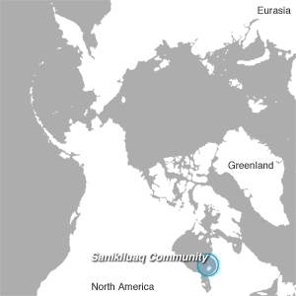
Provenance
Sanikiluaq is located on the Belcher Islands in southeastern Hudson Bay of Canada
Residents rely on hunting for daily supplies
Climate conditions become fickle
Sea ice melt earlier and become dangerous
Observations of environment
Surveys of hunters
Project Type: Original Ingest
Three hunters
Participants
Coordinators of ELOKA
Notes:
Climate conditions become fickle over the past few decades.
To document these environmental changes, the Sanikiluaq Environmental Committee created Sea Ice Project to make long-term observations and to conduct surveys of the traditional hunters for this variation.

Slide 4

Data set
Interviews of three hunters
Observations of sea ice conditions
Maps of ice features and changes
Photographs at specific places
Two in English; the third in Inuktitut and English
Data format: PDF, JPEG on web
Data format: MPEG-4
Data format: MPEG-4
Comments about ice conditions and variations
Websites of project and metadata
Data format: HTML, CSS, embedded media
Data are available via the Product Web Site as edited video files, maps, and photographs.
Full video interviews, maps, and photographs are on ftp as a compressed file via the Access Data link.
Notes:
The local and traditional knowledge (LTK) gathered from these interviews reveals that the ice is changing and becoming more dangerous and less predictable.
Data are available via the Product Web Site as edited video files, maps, and photographs. Full video interviews, maps, and photographs are on ftp as a compressed file via the Access Data link.

Slide 5
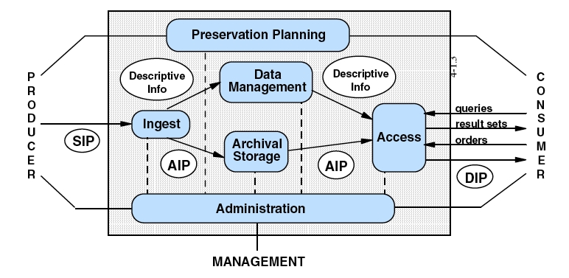
Needs for moving forward
SIP:
Access to comprehensive data collection
Copyright information
Anticipation of preservation
AIP:
Metadata & documentation of each object (interviews, maps and websites) and their relationships
Structured notes of interviews
NSIDC analog archived drafts of maps
DIP:
To provide queries and results access to researchers
To migrate media files to text files if possible
To develop knowledge discovery from original data
Problems:
No documentation available
No See Also links available

Slide 6
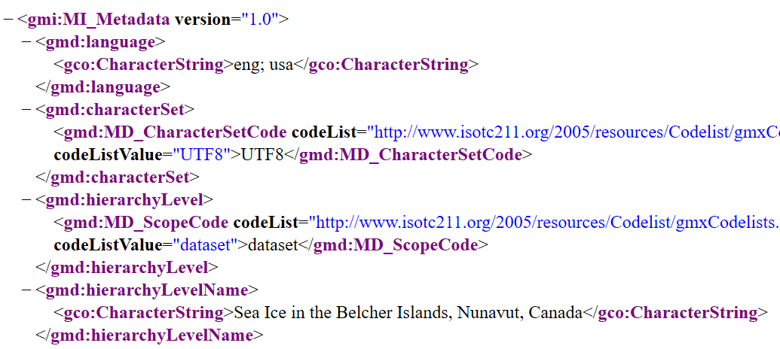
Assess the metadata standard
Sea Ice in the Belcher Islands, Nunavut, Canada, Version 1
Data Set ID: ELOKA002 Version: 1
Data Set Supporting Program: ELOKA
Investigator(s): Abstract:
Location: Spatial Coverage:
Temporal Coverage: 1993-01-01 to 2009-04-01
GCMD Parameter(s):
Platform(s): Sensor(s):
Data Format(s): Keyword(s):
Data Citation:
Data Creation Date: 2010-04-01
Last Updated: 2015-10-08
MI_Metadata:
ISO 19115-2 Metadata Standard for Geographic Data
ISO Namespaces:
provide context and rules for items
Suggestions:
Document creation dates of different files in the collection
Establish a hierarchy for keywords
Create metadata record for each object in the collection

Slide 7
Curation stack model
Layers | Characteristics | Methods
Curation | Adding value throughout life-cycle | - Transfer and reuse data to knowledge for the climate monitoring and the improvement of hunters’ lives
Preservation | Data can be fully used and interpreted | - Preserve within a Data Conservancy instance of NSIDC - Update and replenish metadata with hierarchy - Create documentation for all the objects and their relationships - Use web crawlers to capture content and interactivity, e.g. Heritrix - Keep the schema of websites and migrate embedded media objects to other formats for long-term preservation
Archiving | Data protection including fixity and identifier | - Use the dataset ID assigned by NSIDC - Identify checksums of digital objects for fixity - NSIDC analog archive drafts
Storage | Bits on disks and cloud Backup and restore | - Collect in a directory of different folders for different hunters - Provide access to researchers on NSIDC website

Slide 8
Gains and Lessons from NSIDC curation
A
To support ELOKA’s needs, NSIDC implement an instance of The Data Conservancy solution.
B
Those skilled curators of NSIDC also need relevant technologies and tools.
C
Curators can add value by recognizing, for example that a hunting community’s knowledge of sea ice conditions for travel may also be useful to a climate scientist’s interest in sea ice conditions as a climate indicator.
The implementation includes both technical tools and organizational services for data collection, curation, management, storage, preservation, and sharing.
For example, a data curation system helps curators keep watch on the status of holdings, ensuring that objects are not deteriorating and that data remain uncorrupted.
Tools to support cross-cutting queries can add value by enhancing usability and accessibility of information.

Slide 9
CLIRDLF. (2012). Sayeed Choudhury on Data Stack Model. Retrieved from https://www.youtube.com/watch?time_continue=148&v=3MD7KjZF34Y
Data Set Metadata | National Snow and Ice Data Center. (n.d.). Retrieved from https://nsidc.org/data/eloka002/metadata
Fleming, M. 2010. Sea Ice in the Belcher Islands, Nunavut, Canada, Version 1. [Indicate subset used]. Boulder, Colorado USA. NSIDC: National Snow and Ice Data Center. doi: http://dx.doi.org/10.7265/N5G44N7X.
Hunting for Data Curation Solutions | Data Conservancy. (n.d.). Retrieved from https://dataconservancy.org/hunting-for-data-curation-solutions/
Sanikiluaq Community | eloka-arctic.org. (n.d.). Retrieved from http://eloka-arctic.org/communities/sanikiluaq/index.html

